Slide 1
Analysis of US Unemployment Data of the last three recessions
Hope Diebold, Nepanji Davis, Azmir Suljic, Anggiela Yupanqui, Alex Mull-Dreyer

Slide 2
Outline
Overview
Introduction
Problem Statement & Hypothesis
Recession Timelines
Mapped Timeline
Results
Graphs comparing Unemployment rate with education, gender, and race
Observations from above graphs
References

Slide 3
Introduction
This project presents an analysis of data collected from the Bureau of Labor Statistics.
The aim of this project is to discover basic unemployment trends based on race and ethnicity, educational attainment, and gender and whether there is a significant effect on labor participation during the last three recessions.
Some common associated factors that attribute to labor market differences include variations in:
educational attainment across the groups
occupations and industries in which the groups work
geographic areas of the country in which the groups are concentrated
degree of discrimination encountered in the workplace
Notes:
This project presents an analysis of data collected from the Bureau of Labor Statistics (BLS). To begin our project, we conducted research to determine the factors that contribute to the jobless rates in the US.
A 2018 BLS report completed documented labor force characteristics by race and ethnicity. This report revealed that in addition to race and ethnicity, there are many associated factors to labor market differences. Some of those measurable factors are listed here.
The aim of this project will be to discover basic unemployment trends based on race and ethnicity, educational attainment, and and gender and whether there is a significant effect on labor participation during the last three recessions.

Slide 4
Problem Statement and Hypothesis
Problem Statement:
Finding out the roots of unemployment helps address issues of labor participation and DEI emphasis in future of workforce.
Hypothesis:
Groups facing discrimination in the workforce are correlated with recession unemployment status.
· Race: White employees account for the least amount of employment related discrimination claims based on their race thus will have lower unemployment rates.
· Gender: Male employees account for the least amount of employment related discrimination claims compared to women, thus will have lower unemployment rates.
We can also assume that groups that have attained less education is directly proportional to their ability to be employed, in general, and especially during recessions.
· Education: Employees with less than a high school diploma among all employees thus having lower employment rates compared to more educated workers.
Notes:
Problem Statement:
We are looking to determine the likelihood of unemployment during times of recession in the US based on the previously mentioned labor characteristics. This will help identify roots of unemployment to address issues of diversity, equity, and inclusion (DEI) and the future of employees in the US labor force.
Hypothesis:
From this, we hypothesize that groups facing discrimination in the workforce are correlated with recession unemployment status.
Race: White employees account for the least amount of employment related discrimination claims based on their race, thus will have the lowest unemployment rates.
Gender: Male employees account for the least amount of employment related discrimination claims compared to women, thus will have the lowest unemployment rates.
We can also assume that groups that have attained less education is directly proportional to their unemployment status, in general, and especially during the recession.
Education: Employees with less than a high school diploma among all employees thus having lower employment rates compared to more educated workers.

Slide 5
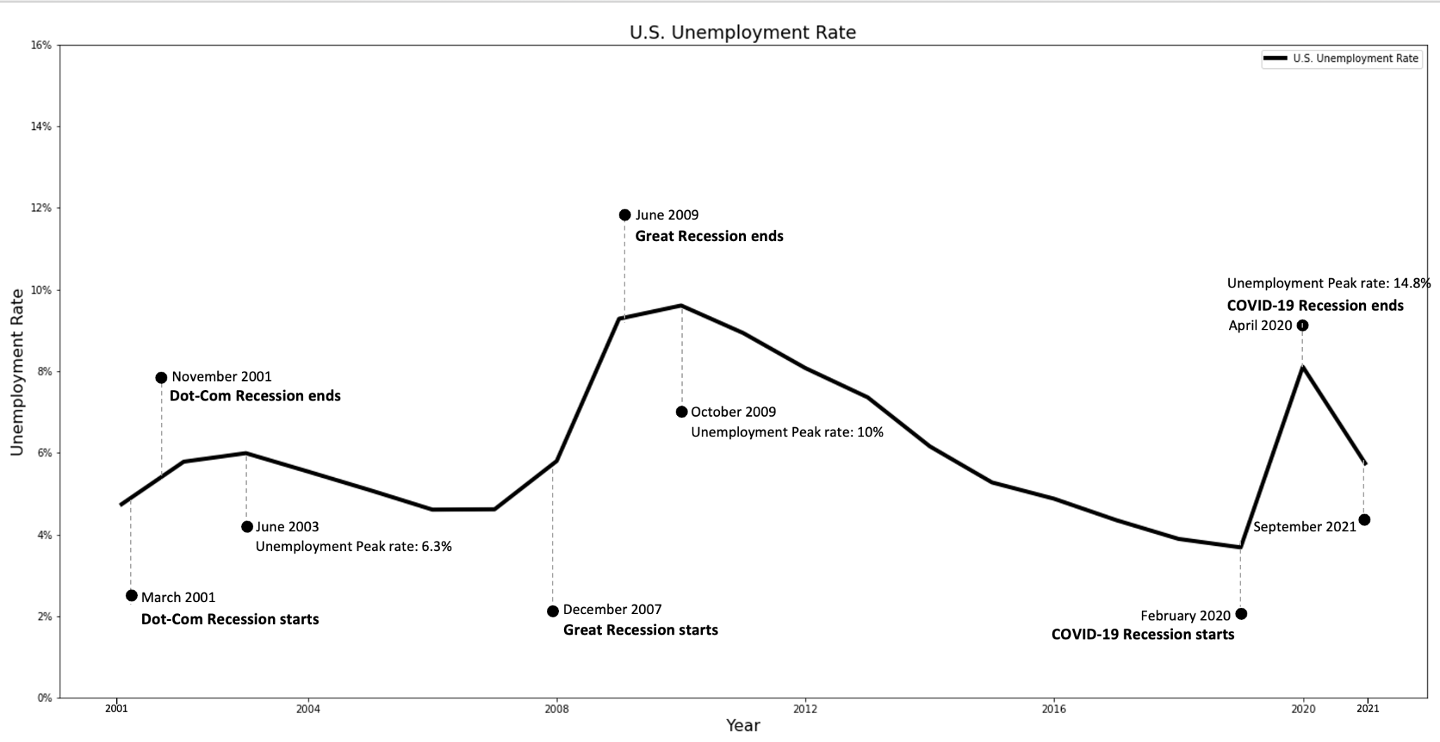
American Unemployment Arc (2001-2021)
Notes:
We evaluated the data over the last three recessions that spanned from 2001 - 2021. The recessions are identified by the following time frames:
Dot-Com - March 2001 - November 2001
Great Recession - December 2007 - June 2009
COVID-19 - February 2020 - April 2020
The findings revealed:
General Findings:
All Unemployment:
Unemployment in the Dot-Com Recession steadily climbed from 4.3% in March 2001 to 5.5% in November 2001.
Unemployment in the Great Recession began at 5% in December 2007 and peaked at 9.5% in June 2009.
Unemployment in the COVID Recession began at 3.5% in February of 2020 and exploded to 14.8% in April 2020.
Unemployment continued to climb even after the official end of the Dot-Com and Great Recessions unlike the Covid-19 Recession which had a sharp decline after its official end.

Slide 6
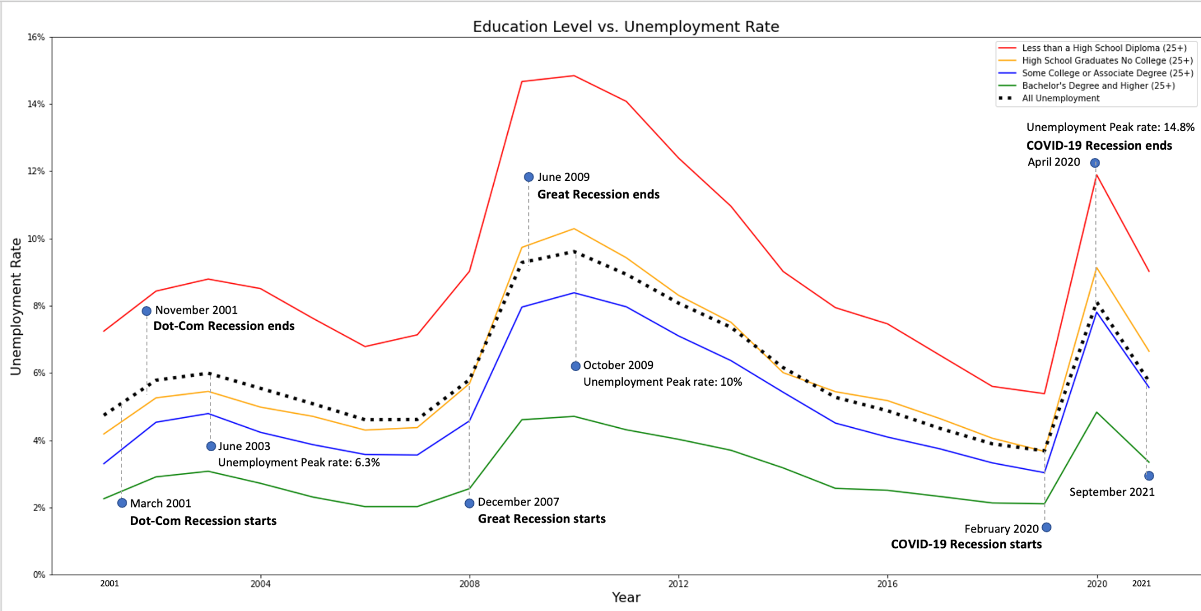
Education vs. Unemployment Rate
Notes:
Education/Unemployment:
Only those with less than a high school diploma have a higher an unemployment rate higher than the average across the 20 year span.
Dot-Com: In the Dot-Com recession, those with some college/associate’s degree had the largest jump in unemployment compared to other educational attainments.
Great-Recession: Employees were more than twice as likely to be unemployed during the Great Recession than those with at least a bachelor's degree. Additionally, even employees with some college or an associate degree were near twice as likely to be unemployed during the Great Recession compared to employees with a bachelor's degree.
Covid Recession: The COVID recession tracked heavily with educational attainment; those without a high school degree jumped by 15% between March and April 2020, those with a HS degree by 13%, some college/associate’s by 12%, and bachelor’s degree and up by 5.9%.

Slide 7
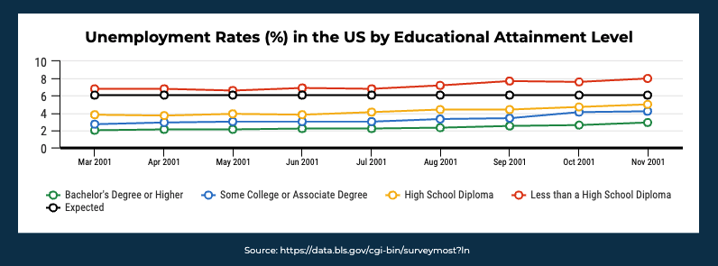
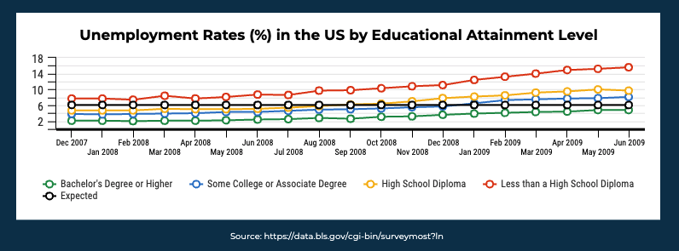
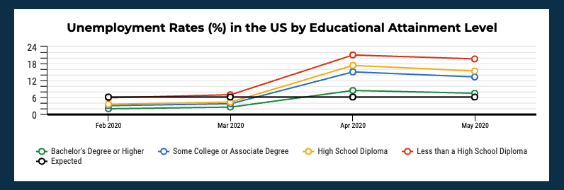
Chi-Square Tests for Education vs. Unemployment
Dot-Com
Great
Covid-19
 | Critical Value | Statistic | p-value
Dot-Com | 7.81 | 4.36 | 0.22
Great | 7.81 | 4.95 | 0.18
Covid | 7.81 | 6.01 | 0.11
Source: https://data.bls.gov/cgi-bin/surveymost?ln
Notes:
After comparing the likelihood of unemployment during times of recession in the US based on education attained, we analyzed the observed results vs the expected to determine if the observed results is due to chance or due to a relationship between the variables being studied.
Ho: proportion of unemployed laborers is independent of their educational attainment across the last three recessions
Ha: proportion of unemployed laborers is different based on their educational attainment for the last three recessions
While there is a noted difference observed that having less than a high school diploma produces higher unemployment rates across each recession, the difference failed to reach significance based on the results of the chi-square tests.

Slide 8
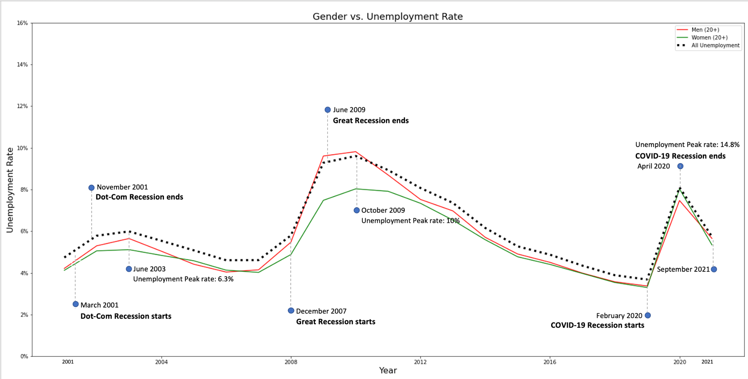
Gender vs. Unemployment Rate
Notes:
Gender/All Unemployment:
Here the unemployment rate for men closely resembles that of the average unemployment rate and it’s generally higher than women across all three recessions.
Dot-Com: Men began the Dot-Com recession with a .2% greater unemployment rate and ended with a .1% greater rate compared to women.
Great-Recession: Men and women diverged in % of unemployment in summer 2008; men proceeded to be 1% more unemployed than women, peaking at 2.3% greater in summer 2009.
Covid Recession: Men started the pandemic recession with a lower unemployment rate than women, but women ended April 2020 with a 2% greater unemployment rate.

Slide 9
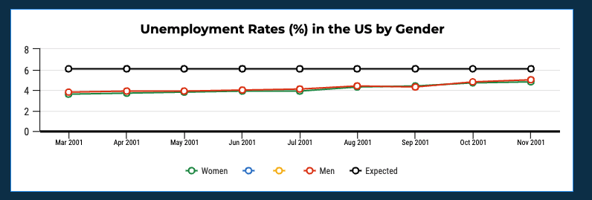
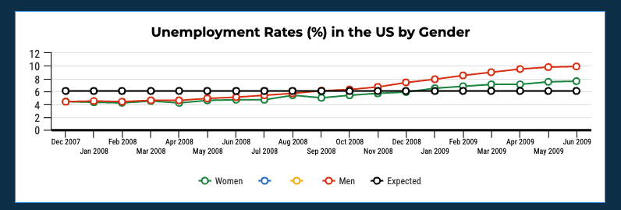
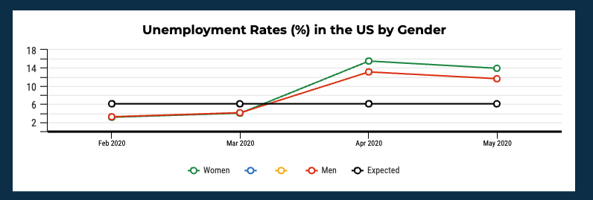
Chi-Square Tests for Gender vs. Unemployment
Dot-Com
Great
Covid-19
 | Critical Value | Statistic | p-value
Dot-Com | 3.84 | 1.18 | 0.28
Great | 3.84 | 0.08 | 0.77
Covid | 3.84 | 0.44 | 0.5
Source: https://data.bls.gov/cgi-bin/surveymost?ln
Notes:
Here, we are comparing the likelihood of unemployment during times of recession in the US based on gender. Again, we analyzed the observed results vs the expected to determine if the observed results is due to chance or due to a relationship between the variables being studied.
Ho: proportion of unemployed laborers is independent of their gender across the last three recessions
Ha: proportion of unemployed laborers is different based on their gender for the last three recessions
While there are noted differences observed in the unemployment rates of men vs women across the recessions, the differences failed to reach significance based on the results of the chi-square tests.

Slide 10
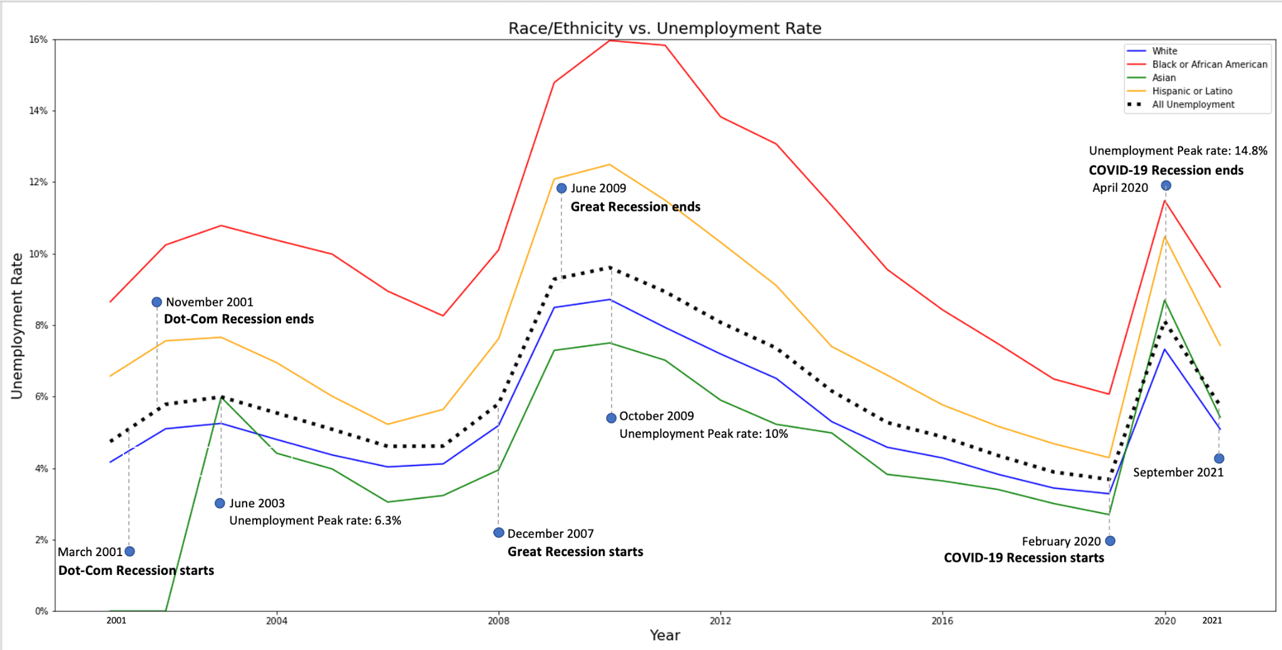
Race vs. Unemployment Rate
Notes:
Race/Unemployment:
An important note: Asian Americans were not identified as a race by the BLS until 2003 so their labor participation was not observed until 2003.
Dot_Com: The Dot-Com recession had a 1% unemployment rate increase and all races but Black tracked closely with the national average.
Great-Recession: Hispanic/Latinos were unemployed at a 2% lower rate than Black Americans through the Great Recession. Asians consistently had a lower unemployment rate through the Great Recession, generally 0.5-1% behind whites.
Covid Recession: Hispanics had the largest jump in unemployment for the COVID recession from Mar-April 2020 (12.9%); Black/Af-Am had about .2% less of a jump than Whites in the same period (10.2% vs. 9.9%).

Slide 11
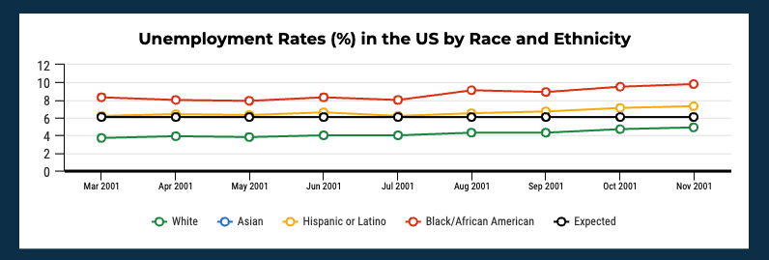
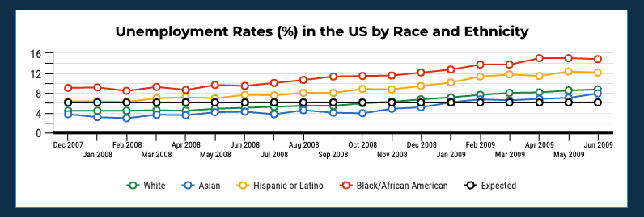
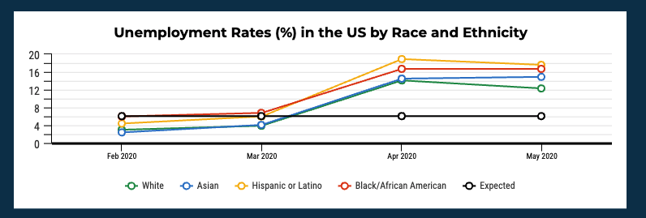
Chi-Square Tests for Race vs. Unemployment
Dot-Com
Great
Covid-19
 | Critical Value | Statistic | p-value
Dot-Com | 7.81 | 1.72 | 0.42
Great | 7.81 | 5.98 | 0.11
Covid | 7.81 | 4.86 | 0.18
Source: https://data.bls.gov/cgi-bin/surveymost?ln
Notes:
Lastly, we are comparing the likelihood of unemployment during times of recession in the US based on race and ethnicity. Again, we analyzed the observed results vs the expected to determine if the observed results is due to chance or due to a relationship between the variables being studied.
Ho: proportion of unemployed laborers is independent of their race and ethnicity across the last three recessions
Ha: proportion of unemployed laborers is different based on their race and ethnicity for the last three recessions
While there are noted differences observed that Blacks and Hispanics have a higher unemployment rate across all three recessions, the differences failed to reach significance based on the results of the chi-square tests.

Slide 12
Conclusion
There were obvious observations noted in the comparisons:
Having less than a high school diploma produces higher unemployment rates across each recession
Blacks and Hispanics have a higher unemployment rate across each recession
In conclusion, while there are noted differences in race and ethnicity, as well as education, these differences did not change during times of recession.
Notes:
There were obvious observations noted in the comparisons:
Having less than a high school diploma produces higher unemployment rates across each recession
Blacks and Hispanics have a higher unemployment rate across each recession
In conclusion, while there are noted differences in race and ethnicity, as well as education, these differences did not change during times of recession.

Slide 13
References
https://www.thebalance.com/the-history-of-recessions-in-the-united-states-3306011
https://data.bls.gov/cgi-bin/surveymost?ln
https://www.bls.gov/cps/rvcps03.pdf
https://www.bls.gov/opub/reports/race-and-ethnicity/2018/home.htm
https://www.betterevaluation.org/en/evaluation-options/LineGraph
https://www.nber.org/news/business-cycle-dating-committee-announcement-july-19-2021
https://en.wikipedia.org/wiki/List_of_recessions_in_the_United_States

